Slide 1


UNIVERSITY INSTITUTE OF ENGINEERING
COMPUTER SCIENCE & ENGINEERING
Introduction to Information Security
(Subject Code:20CST-354/ITT-354)
Prepared By : Er. Puneet kaur(E6913)
INTRODUCTION
DISCOVER . LEARN . EMPOWER

Slide 2
Lecture -2.2
(Public Key Cryptography)

Slide 3
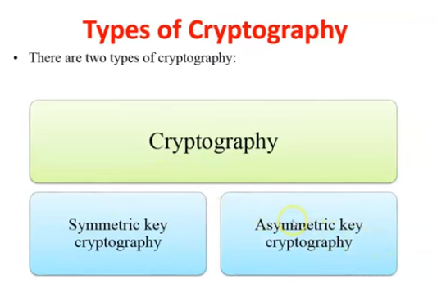

Slide 4
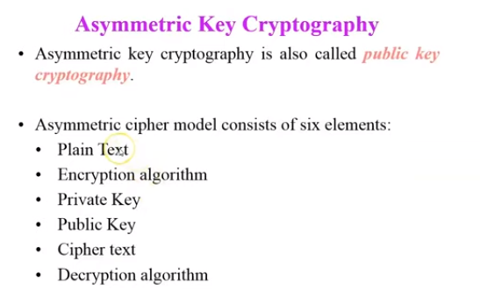

Slide 5
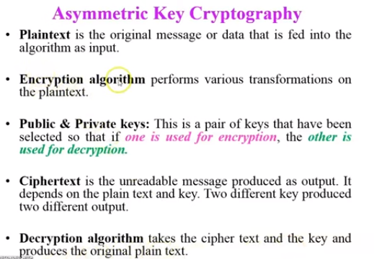

Slide 6
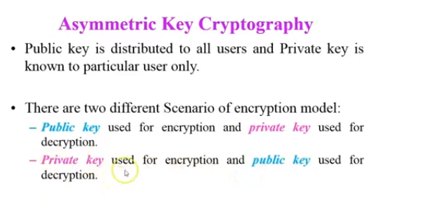

Slide 7
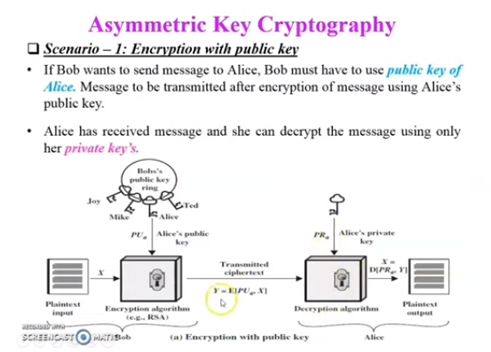

Slide 8
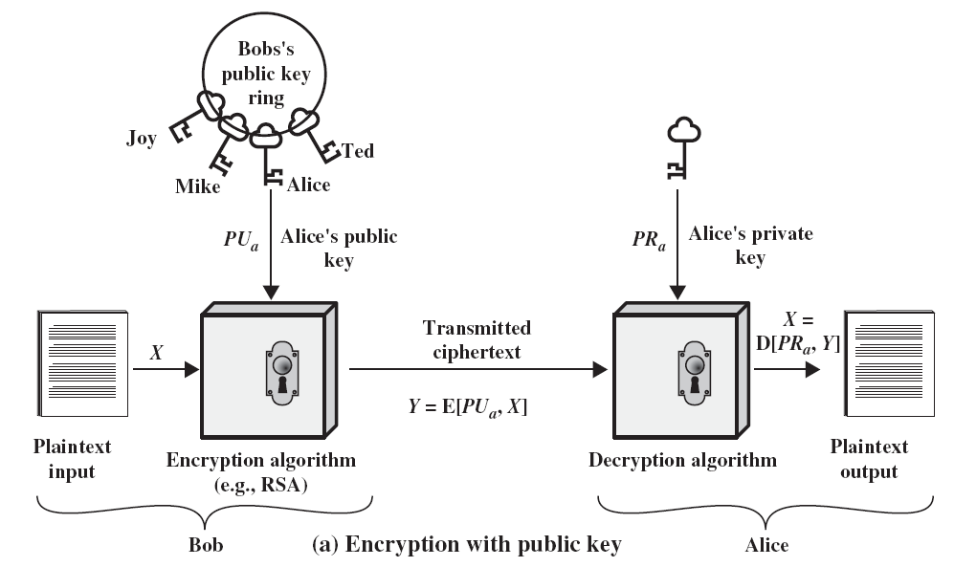
Public Key Cryptosystem

Slide 9
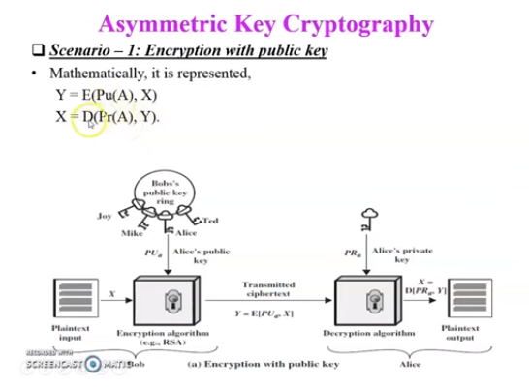

Slide 10
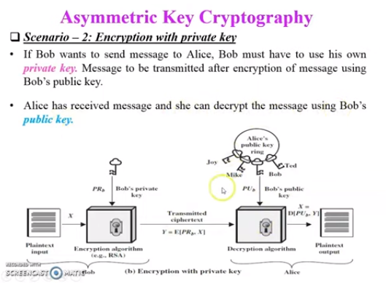

Slide 11
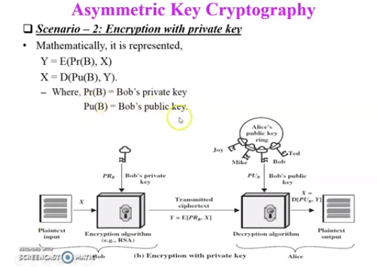

Slide 12
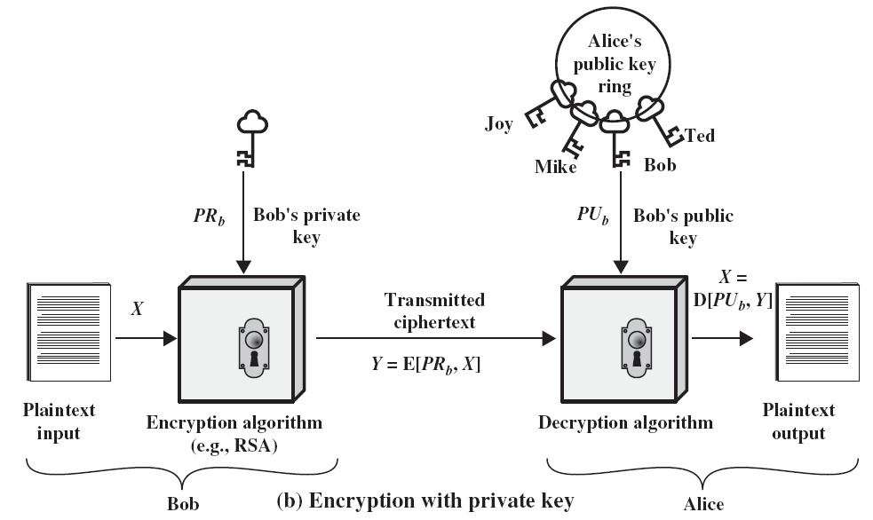
Public Key Cryptosystem

Slide 13
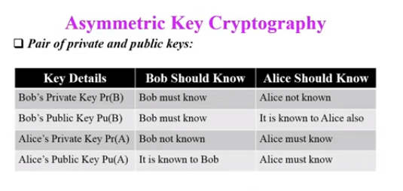

Slide 14
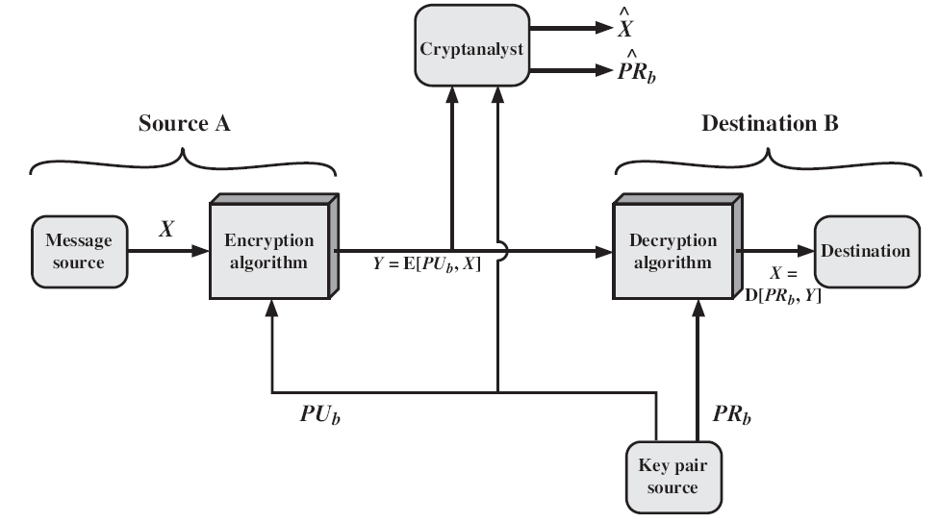
Essential Elements of Public Key Systems

Slide 15
Essential Elements of Public Key Systems
Source A produces a message in plaintext X = [X1, X2,…XM]
The M elements of X are letters in some finite alphabet.
B generates a related pair of keys: a public key, PUb, and a private key, PRb.
PRb is known only to B, whereas PUb is publicly available and therefore accessible by A.

Slide 16


Essential Elements of Public Key Systems
With the message X and the encryption key PUb as input, A forms the ciphertext Y = [Y1, Y2,…YM]
The intended receiver, in possession of the matching private key, is able to invert the transformation:

Slide 17

Essential Elements of Public Key Systems
We know that either of the two related keys can be used for encryption, with the other being used for decryption.
This enables a rather different cryptographic scheme to be implemented for providing authentication.

Slide 18
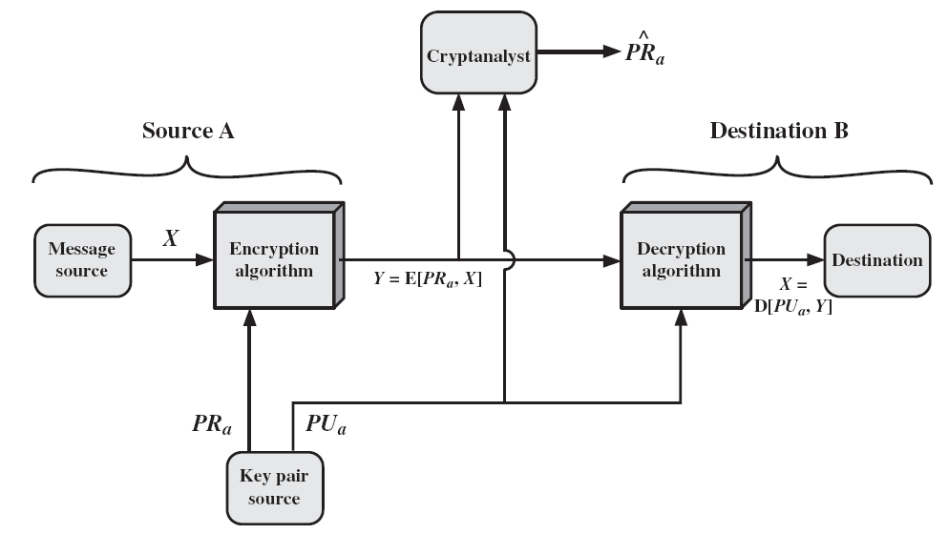
Essential Elements of Public Key Systems

Slide 19
Essential Elements of Public Key Systems
In this case, the entire encrypted message serves as a digital signature.
It is impossible to alter the message without access to A’s private key, so the message is authenticated both in terms of source and in terms of data integrity.
This approach does not provide Confidentiality (because any observer can decrypt the message by using the sender’s public key).

Slide 20
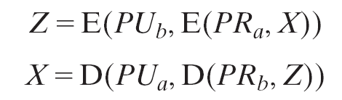
Essential Elements of Public Key Systems
It is, however, possible to provide both the authentication function and confidentiality by a double use of the public-key scheme.
Complex in nature. Must be exercised four times rather than two in each communication.

Slide 21
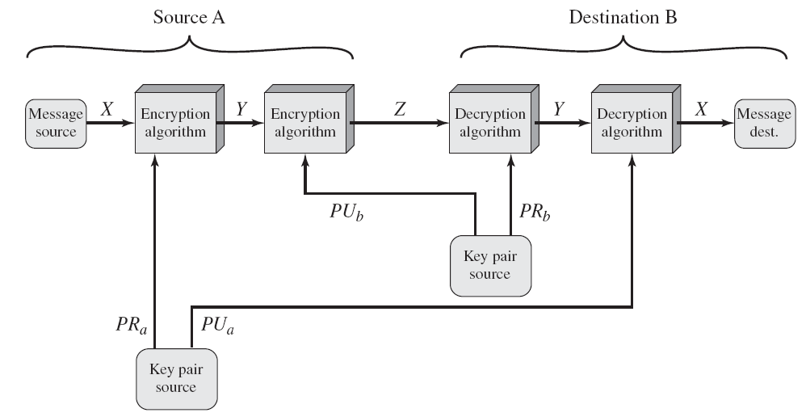
Essential Elements of Public Key Systems

Slide 22
Applications for Public Key Systems
Public-key systems are characterized by the use of a cryptographic algorithm with two keys, one held private and one available publicly.
Depending on the application, the sender uses either the sender’s private key or the receiver’s public key, or both, to perform some type of cryptographic function.
Public-key cryptosystems can be classified into three categories

Slide 23
Applications for Public Key Systems
Encryption /decryption
The sender encrypts a message with the recipient’s public key.
Digital signature
The sender “signs” a message with its private key.
Signing is achieved by a cryptographic algorithm applied to the message or to a small block of data that is a function of the message.

Slide 24
Applications for Public Key Systems
Key Exchange
Two sides cooperate to exchange a session key. Several different approaches are possible, involving the private key(s) of one or both parties

Slide 25
References
http://www.brainkart.com/article/Classical-Encryption-Techniques_8339/
https://www.tutorialspoint.com/cryptography/index.htm
https://www.geeksforgeeks.org/cryptography-introduction/
https://www.techopedia.com/definition/1770/cryptography#:~:text=Cryptography%20involves%20creating%20written%20or,information%20to%20be%20kept%20secret.&text=Information%20security%20uses%20cryptography%20on,transit%20and%20while%20being%20stored.

Slide 26
E- Books Recommended
https://www.pdfdrive.com/cyber-security-books.html
https://bookauthority.org/books/new-cyber-security-ebooks
https://bookauthority.org/books/best-cyber-security-ebooks
https://www.freetechbooks.com/information-security-f52.html

